Slide 1

CGB1201 – JAVA PROGRAMMING
Department of Artificial Intelligence and Data Science
Academic Year: 2024 – 2025 (Odd Semester)
Register Number : 2303811724322038
Name : Irin Minerwa S
Year : II
Semester : III
Section : A
Date : 07.12.2024

Slide 2
Title of the Project
ONLINE VOTING SYSTEM

Slide 3
Problem Identification
The Online Voting System is designed to automate the voting process, but there are several challenges that need to be addressed for it to work effectively and securely. Here's a simplified version of the problems identified:
Security Issues: The system uses basic password hashing, which could be vulnerable. Implement stronger security measures like multi-factor authentication.
Scalability: Data is stored in memory, limiting scalability. Use a database for persistent storage.
Weak Voter Authentication: Simple ID and password authentication may not be secure. Add stronger identity verification methods.
Preventing Fraud: The system lacks real-world voter verification. Integrate with government databases or add additional check.
Input Validation: The system doesn't handle invalid inputs well. Implement better validation and error handling.
Vote Integrity: Vote counts are lost if the system crashes. Store votes in a secure database.

Slide 4
Objective
The objective of the Online Voting System is to create a secure, easy-to-use platform for digital voting. The main goals are:
Secure Login: Ensure only authorized voters can vote using a Voter ID and password.
Easy Voting: Allow voters to easily select and vote for their chosen candidate.
Real-Time Vote Counting: Track and update the vote count instantly.
Show Results: Display the election results clearly after voting.
User-Friendly: Make the system simple and accessible for all voters.
Future Improvements: Provide a foundation for adding more security and features for larger elections.

Slide 5
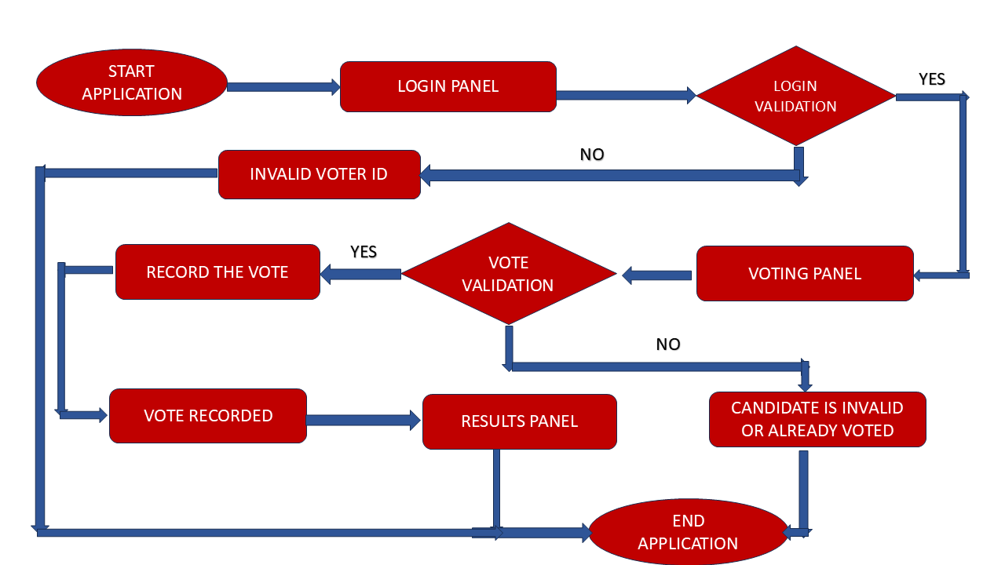
Proposed Architecture

Slide 6
Java Programming - Concepts Used
Object-Oriented Programming (OOP): The Online Voting System follows Object-Oriented Programming (OOP) principles to structure the system. It uses classes like Voter, VotingSystem, and Candidate to represent entities and their actions. This helps in organizing the system into different modules, such as login, voting, and results. OOP makes the system more modular, reusable, and easier to maintain. By encapsulating each component in its own class, the system becomes scalable and easier to extend.
Data Structures (HashMap): HashMap is used to store and manage important data efficiently in the system. Voter credentials, such as voter IDs and hashed passwords, are stored in a HashMap for fast validation during login. The vote counts for each candidate are also stored in a HashMap, allowing quick updates and retrieval. This data structure ensures efficient lookups, insertions, and deletions. HashMap’s fast performance makes it ideal for managing real-time vote counting and voter authentication.

Slide 7
List of Modules
Login Module
Voting Module
Results Module
Security Module
User Interface (UI) Module
Vote Counting Module

Slide 8
Module 1 Description
Login Module:
The Login Module handles voter authentication. It allows users to input their Voter ID and password. The entered credentials are compared against stored, hashed passwords using the HashMap data structures.
If the credentials are correct and the voter has not already voted, they are granted access to vote.
If the credentials are incorrect or the voter has already voted, appropriate messages are displayed.

Slide 9
Module 2 Description
Voting Module:
The Voting Module allows authenticated voters to cast their vote. After successful login, voters are presented with the list of candidates.
They can input the candidate's name they wish to vote for, which is validated against the available candidates.
Once a valid candidate is selected, their vote count is updated, and the voter is marked as having voted using a HashMap.

Slide 10
Module 3 Description (Cont..)
Results Module:
The Results Module displays the election results after voting. It shows the number of votes for each candidate stored in a HashMap.
This module is accessible after a voter has cast their vote, or by requesting the results directly.
It aggregates the vote counts from the candidatesVotes map and displays them in a user-friendly format.

Slide 11
Source Code
import javax.swing.*;
import java.awt.*;
import java.awt.event.*;
import java.security.MessageDigest;
import java.util.HashMap;
import java.util.Map;
public class OnlineVotingSystem {
private static Map<String, Integer> candidatesVotes = new HashMap<>();
private static final String[] candidates = {"Candidate C", "Candidate B", "Candidate A"};
private static final Map<String, String> voters = new HashMap<>();
private static final Map<String, Boolean> hasVoted = new HashMap<>();
static {
voters.put("voterhashPassword("password1"));
voters.put("voter2",hashPassword("password2"));
voters.put("voterhashPassword("password3"));
for (String candidate : candidates) {
candidatesVotes.put(candidate, 0);
}}

Slide 12
Source Code
public static void main(String[] args) {
JFrame frame = new JFrame("Online Voting System");
frame.setSize(400, 300); frame.setDefaultCloseOperation(JFrame.EXIT_ON_CLOSE);
CardLayout cardLayout = new CardLayout();
JPanel mainPanel = new JPanel(cardLayout);
JPanel loginPanel = createLoginPanel(cardLayout, mainPanel);
mainPanel.add(loginPanel, "Login");
JPanel votingPanel = createVotingPanel(cardLayout, mainPanel);
mainPanel.add(votingPanel, "Vote");
JPanel resultsPanel = createResultsPanel();
mainPanel.add(resultsPanel, "Results");
frame.add(mainPanel);
frame.setVisible(true);
private static JPanel createLoginPanel(CardLayout cardLayout, JPanel mainPanel) {
JPanel loginPanel = new JPanel();
loginPanel.setLayout(new GridLayout(3, 2));

Slide 13
Source Code
public void actionPerformed(ActionEvent e) {
String voterId = voterIdField.getText();
String password = new String(passwordField.getPassword());
if (voters.containsKey(voterId) && voters.get(voterId).equals(hashPassword(password))) {
if (hasVoted.getOrDefault(voterId, false)) {
JOptionPane.showMessageDialog(loginPanel, "You have already voted."); } else {
JOptionPane.showMessageDialog(loginPanel, "Login successful!");
JLabel voterIdLabel = new JLabel("Enter Voter ID: ");
JTextField voterIdField = new JTextField();
JLabel passwordLabel = new JLabel("Enter Password: ");
JPasswordField passwordField = new JPasswordField();
JButton loginButton = new JButton("Login");
loginButton.addActionListener(new ActionListener() {
@Override

Slide 14
Source Code
cardLayout.show(mainPanel, "Vote"); } else { JOptionPane.showMessageDialog(loginPanel, "Invalid Voter ID or Password.")
}} }); loginPanel.add(voterIdLabel);
loginPanel.add(voterIdField);
loginPanel.add(passwordLabel); loginPanel.add(passwordField);
loginPanel.add(loginButton);
return loginPanel;} private static JPanel createVotingPanel(CardLayout cardLayout, JPanel mainPanel) {
JPanel votingPanel = new JPanel();
votingPanel.setLayout(new BoxLayout(votingPanel, BoxLayout.Y_AXIS));
JLabel candidatesLabel = new JLabel("Candidates: ");
for (String candidate : candidates) {
candidatesLabel.setText(candidatesLabel.getText() + candidate + ", ");}
JLabel voteLabel = new JLabel("Enter your vote (Candidate Name): ");
JTextField voteField = new JTextField();
JButton voteButton = new JButton("Cast Vote");
voteButton.addActionListener(new ActionListener() {

Slide 15
Source Code
@Override
public void actionPerformed(ActionEvent e) { String vote =voteField.getText().trim();
String voterId = voteField.getText().trim(); if (candidatesVotes.containsKey(vote) && !hasVoted.getOrDefault(voterId, false)) { candidatesVotes.put(vote, candidatesVotes.get(vote) + 1);
hasVoted.put(voterId, true); JOptionPane.showMessageDialog(votingPanel, "Your vote has been cast successfully!");
int response = JOptionPane.showConfirmDialog(votingPanel, "Would you like to see the results?", "Election Results", JOptionPane.YES_NO_OPTION);
if (response == JOptionPane.YES_OPTION) {
cardLayout.show(mainPanel, "Results");}
} else {
JOptionPane.showMessageDialog(votingPanel, "Invalid candidate name or you have already voted.");
}}});
add(candidatesLabel);
votingPanel.add(voteLabel);

Slide 16
Source Code
votingPanel.add(voteField); votingPanel.add(voteButton);
return votingPanel;}
private static JPanel createResultsPanel() {
JPanel resultsPanel = new JPanel();
resultsPanel.setLayout(new BoxLayout(resultsPanel, BoxLayout.Y_AXIS));
JButton resultsButton = new JButton("Show Results");
resultsButton.addActionListener(new ActionListener() { @Override
public void actionPerformed(ActionEvent e) {
StringBuilder results = new StringBuilder("<html><h3>Election Results:</h3>");
for (String candidate : candidates) {
results.append(candidate).append(":").append(candidatesVotes.get(candidate)).append(" votes<br>");}
results.append("</html>");
JOptionPane.showMessageDialog(resultsPanel, results.toString());}});
resultsPanel.add(resultsButton);
return resultsPanel;
}

Slide 17
Source Code
private static String hashPassword(String password) {
try {
MessageDigest md = MessageDigest.getInstance("SHA-256");
byte[] hashBytes = md.digest(password.getBytes());
StringBuilder sb = new StringBuilder();
for (byte b : hashBytes) {
sb.append(String.format("%02x", b)); }
return sb.toString();
} catch (Exception e) {
throw new RuntimeException("Error hashing password", e);
}}
}

Slide 18
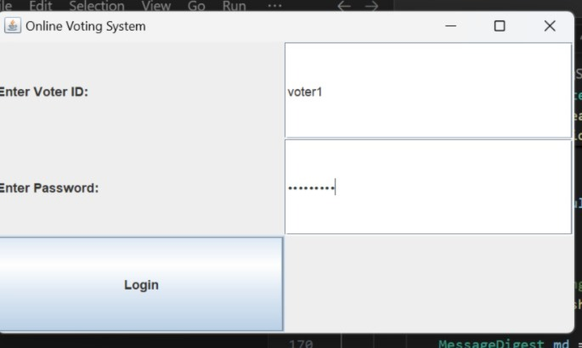
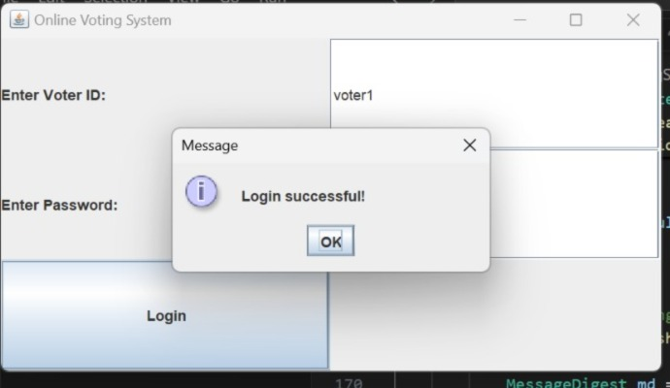
Results

Slide 19
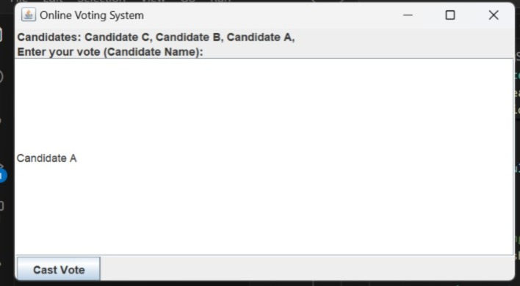
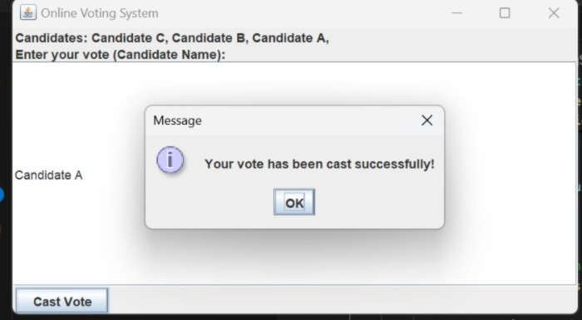
Results

Slide 20
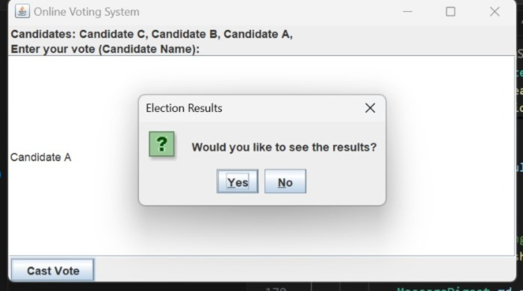
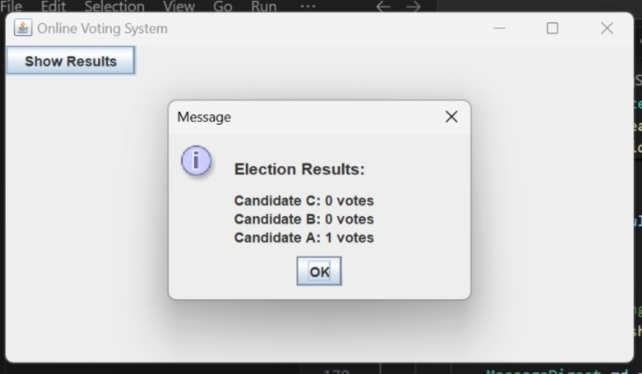
Results

Slide 21
Conclusion
The Online Voting System project shows how technology can make elections secure, clear, and efficient using Java. It uses a graphical user interface (GUI) and secure password encryption (SHA-256) to make sure that only verified voters can vote. The system prevents multiple votes from the same person and displays the results correctly once voting is over.
Important features like user login, vote tracking, and showing results are well implemented, creating a simple and secure way to conduct elections. The system is designed in a way that makes it easy to maintain and improve, so it can be used for different types of elections like government, organizations, or schools. This project shows how technology can make elections more trustworthy and accessible.

Slide 22
Thank You
Any queries???

